Slide 1
Lecture 24

Slide 2
First Minimum
Circular Aperture
θ
D
w
Central Maximum
Intensity Pattern
L

Slide 3
First Minimum
Slit Aperture
θ
y
a
width
Intensity Pattern
Central Maximum
L

Slide 8
Resolution

Slide 9
Question 223.19.1
Resolution is
The ending argument in a debate
The ability to distinguish separate point sources in an optical image
The distance between bright fringes in a diffraction pattern
The distance between dark fringes in a diffraction pattern

Slide 10
Question 233.19.2
Cat’s eyes have pupils that can be modeled as vertical slits. At night, would cats be more successful in resolving
Headlights on a distant car
Vertically separated lights on the mast of a distant boat?

Slide 11
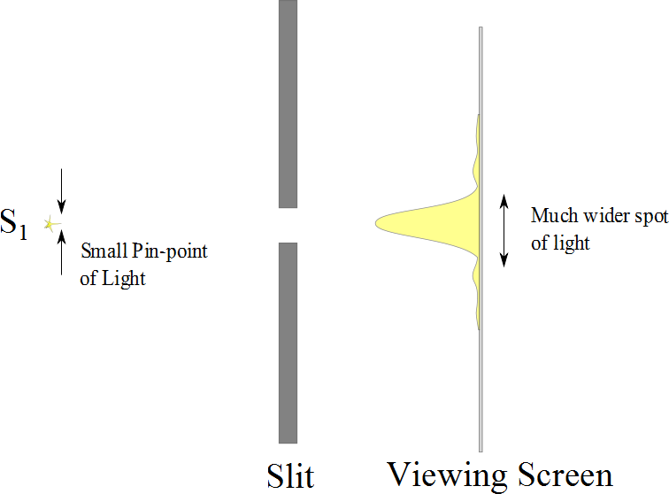

Slide 12
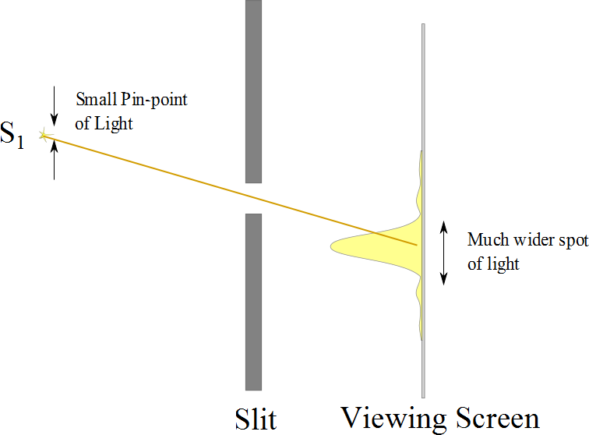

Slide 13
Resolution
The ability of optical systems to distinguish between closely spaced objects is limited because of the wave nature of light
If two sources are far enough apart to keep their central maxima from overlapping, their images can be distinguished
The images are said to be resolved
If the two sources are close together, the two central maxima overlap and the images are not resolved

Slide 14


Slide 15
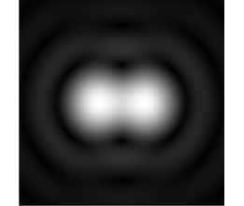

Slide 16
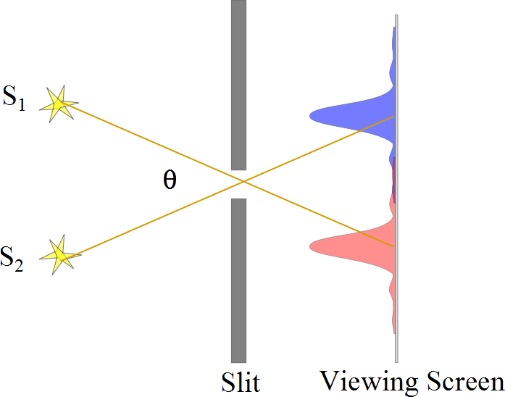
Resolved Images, Example

Slide 17
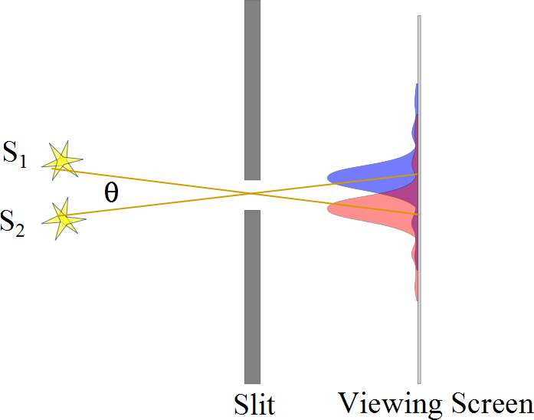
Barely Resolved, Example

Slide 18
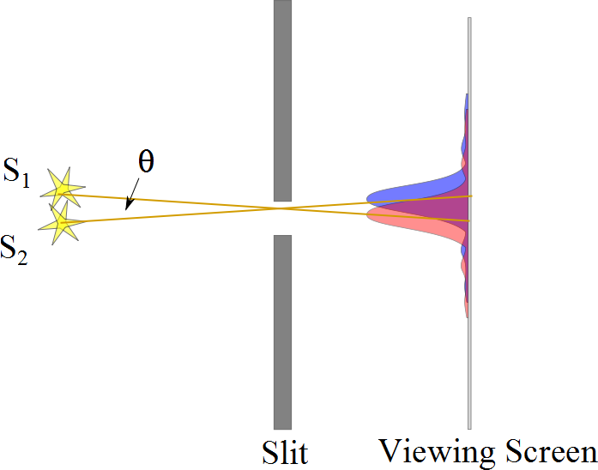
Images Not Resolved, Example

Slide 19
Resolution
The ability of optical systems to distinguish between closely spaced objects is limited because of the wave nature of light
If two sources are far enough apart to keep their central maxima from overlapping, their images can be distinguished
The images are said to be resolved
If the two sources are close together, the two central maxima overlap and the images are not resolved

Slide 21
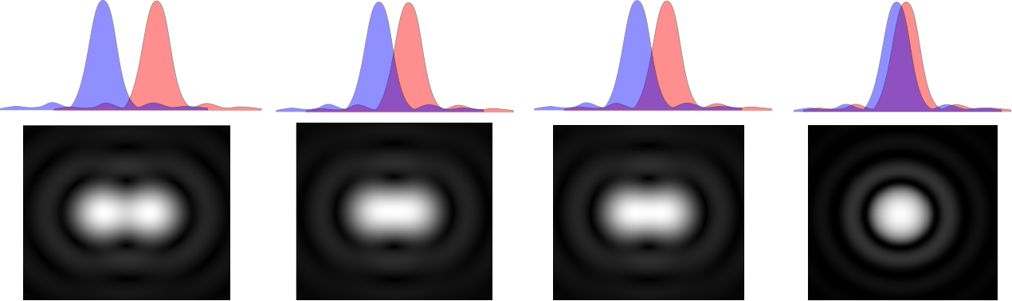

Slide 23
Resolution, Rayleigh’s Criterion
When the central maximum of one image falls on the first minimum of another image, the images are said to be just resolved
This limiting condition of resolution is called Rayleigh’s criterion

Slide 24
Resolution, Rayleigh’s Criterion, Equation
The angle of separation, θ_{min}, is the angle subtended by the sources for which the images are just resolved
Since λ << a in most situations, sin θ is very small and sin θ ≈ θ
Therefore, the limiting angle (in rad) of resolution for a slit of width a is
To be resolved, the angle subtended by the two sources must be greater than θ_{min}

Slide 25
Circular Apertures
The diffraction pattern of a circular aperture consists of a central bright disk surrounded by progressively fainter bright and dark rings
The limiting angle of resolution of the circular aperture is
D is the diameter of the aperture

Slide 26
Completely Resolved
Rayleigh Criterion
Sparrow Criterion
Unresolved

Slide 27
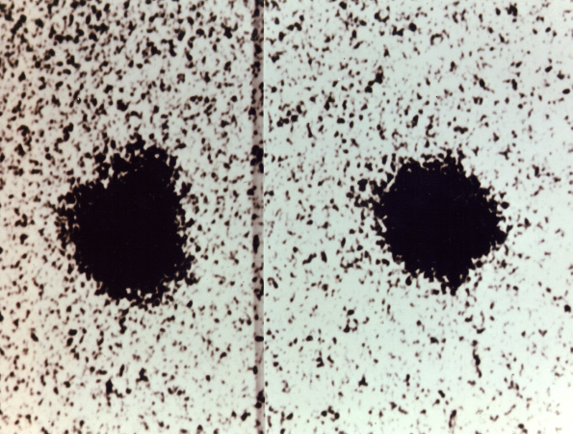
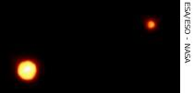
Resolution, Example
Charon
Pluto
Pluto and its moon, Charon
Left: Earth-based telescope is blurred
Right: Hubble Space Telescope clearly resolves the two objects

Slide 28
Holography
Beam Splitter
Mirror)
Light from laser expanded with beam expander
Interference Pattern
(Hologram)
Object

Slide 29
Holography Reconstruction
Mirror)
Light from laser expanded with beam expander
Interference Pattern
(Hologram)
Reconstructed Image of Object

Slide 30
Diffraction of X-Rays by Crystals
X-rays are electromagnetic waves of very short wavelength
Max von Laue suggested that the regular array of atoms in a crystal could act as a three-dimensional diffraction grating for x-rays

Slide 32
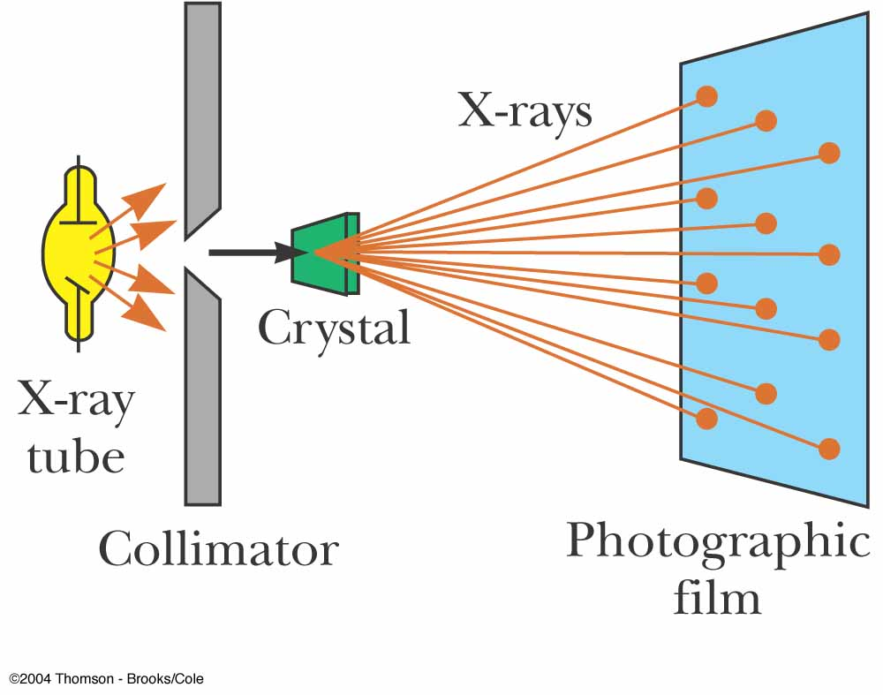
Diffraction of X-Rays by Crystals, Set-Up
A collimated beam of monochromatic x-rays is incident on a crystal
The diffracted beams are very intense in certain directions
This corresponds to constructive interference from waves reflected from layers of atoms in the crystal
The diffracted beams form an array of spots known as a Laue pattern

Slide 33
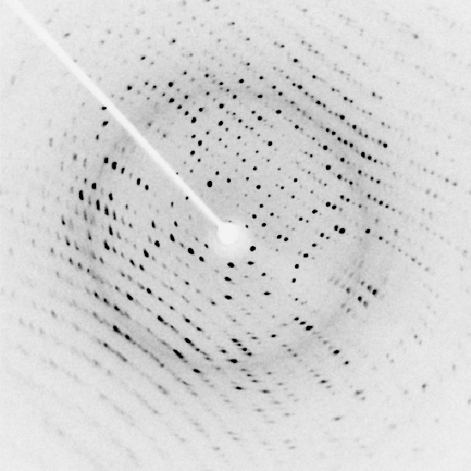

Slide 34
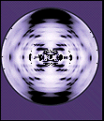

Slide 35
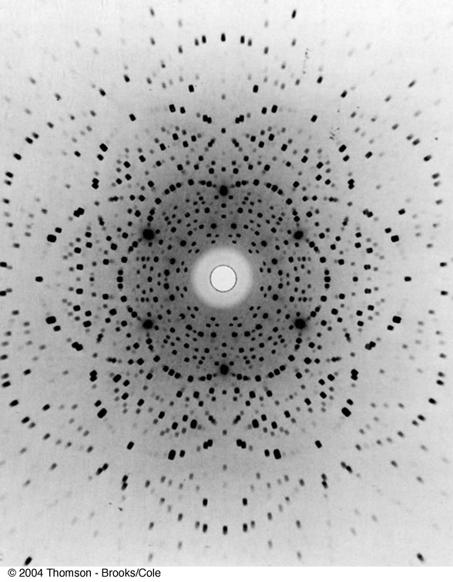
Laue Pattern for Beryl

Slide 36
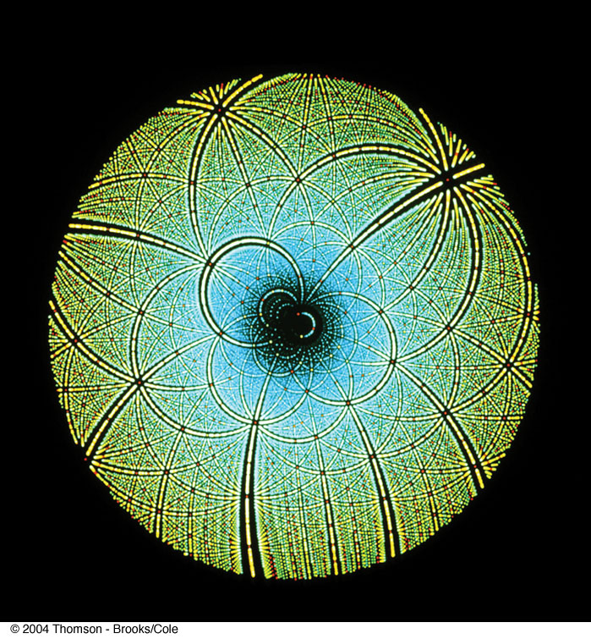
Laue Pattern for Rubisco

Slide 37
Question 223.12.3
I have a circular aperture illuminated by a laser. The aperture Diameter is E and the light that passes through the slit lands on the screen, a distance L away. If the aperture size increases, the size of the central spot will
Increase
Decrease
Stay the same
Impossible to tell

Slide 38
Question 223.12.4
I have a laser pointer with a wavelength of 632nm and a beam profile that is about half a millimeter across. I shine it through a circular aperture with a diameter of 1m. About how big is the central spot on a screen 10m away?
6.1683 x 10⁻⁶m
A few millimeters
Maybe a centimeter or two
About a meter

Slide 39
Question 223.13.0.6
I have radar waves (λ = 3.2cm) that illuminate a circular aperture with diameter of 2mm. Will the wave nature of light be important?
Yes
No
Maybe

Slide 40
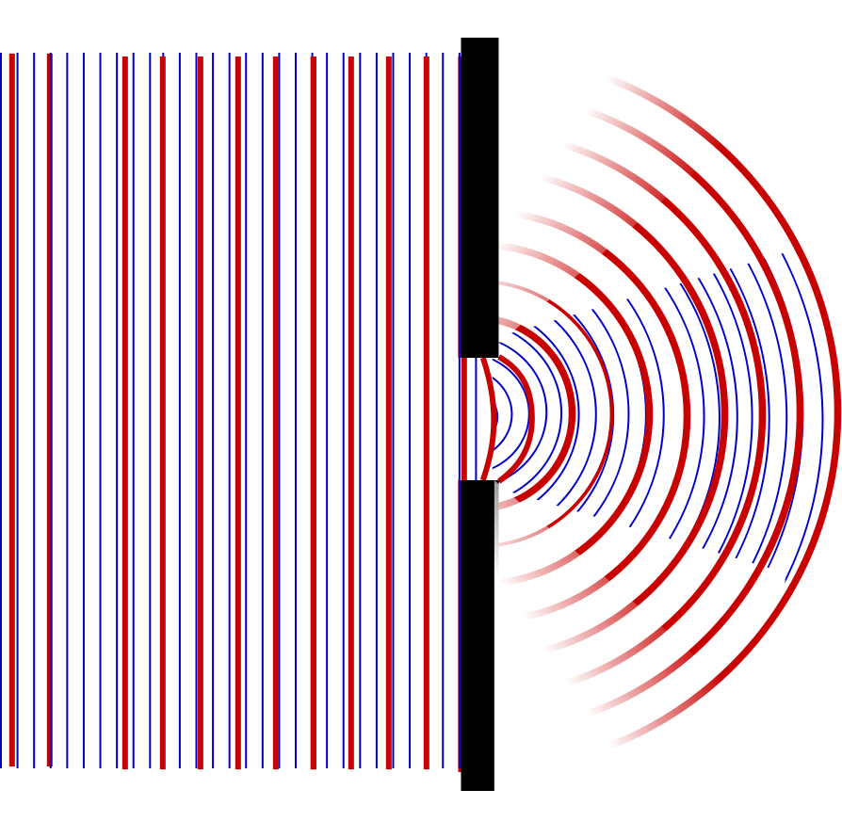

Slide 41
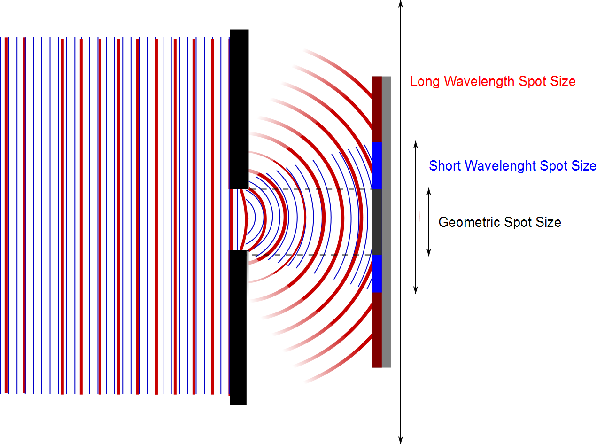

Slide 42
Question 223.13.0.5
I have radar waves (λ = 3.2cm) that illuminate a circular aperture with diameter of 2m. Will the wave nature of light be important?
Yes
No
Maybe

Slide 43
Question 223.13.0.7
I have radar waves (λ = 3.2cm) that illuminate a circular aperture with diameter of 3.2cm. Will the wave nature of light be important?
Yes
No
Take another physics class to find out

Slide 44
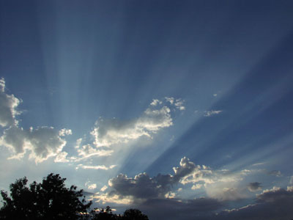
Question 223.13.1
You are in the western US and you observe a dramatic sunset. The Sun is descending through a bank of clouds and you see light and dark bands . What is causing these?
Constructive and Destructive Interference from the light traveling through small slits in the mountains
Constructive and Destructive Interference from the light traveling through small openings in the clouds
The dark bands are cloud or mountain shadows
Crepuscular rays: Image public domain http://commons.wikimedia.org/wiki/File:Crepuscular_rays.jpg

Slide 45
Question 223.13.1.5
If I take two light bulbs near each other, will I observe interference where the light from the bulbs meet?
Yes
No

Slide 46
Question 223.13.2
Will light from two sources that starts in phase necessarily stay in phase?
Yes, if the initial phase is the same, the light will stay in phase
No, the light might have different wavelengths, which will cause the phase to diverge
No, The light might take different paths, which would cause a relative phase

Slide 47
Question 123.13.3
Which of the following would likely be a coherent source?
Laser
Light bulb
Glow stick
Radio transmission
Black body emission

Slide 48


Slide 51
End

